Slide 1

Practical Data Modeling for Production
With Kotlin

Slide 2
Course Mission
Present Kotlin as a platform to seamlessly integrate the entire data science supply chain, from ETL (Extract-Transform-Load) to DAD (Discover-Access-Distill), and finally to production.
From Data Science to Production with Kotlin will cover the fundamentals of the Kotlin language, while Practical Data Modeling for Production with Kotlin will expand on advanced features and practical applications.

Slide 3
Prerequisites
This class is a continuation of another O'Reilly video From Data Science to Production, with Kotlin.
Please view this other video as a prerequisite if you are not familiar with the Kotlin language.

Slide 4
Agenda
Working with data sources in Kotlin (text files, SQL, web requests)
Functional programming with Kotlin
Adapting Kotlin to your business domain
Practical Applications of Kotlin for Data Science

Slide 5
Operator Functions
Symbol Signature | Operator Function
a + b | a.plus(b)
a - b | a.minus(b)
a / b | a.div(b)
a * b | a.times(b)
a % b | a.rem(b)
a..b | a.rangeTo(b)
a -= b | a.minusAssign(b)
a *= b | a.timesAssign(b)
a /= b | a.divAssign(b)
a %= b | a.remAssign(b)
a in b​ | b.contains(a)​
a !in b​ | !b.contains(a)​
a[i]​ | a.get(i)​
a[i, j]​ | a.get(i, j)​
a[i_1, ..., i_n]​ | a.get(i_1, ..., i_n)​
a[i] = b​ | a.set(i, b)​
a[i, j] = b​ | a.set(i, j, b)​
a[i_1, ..., i_n] = b​ | a.set(i_1, ..., i_n, b)​

Slide 6
Going Forward
If you have gotten this far, congrats! You have a fundamental mastery of Kotlin for the purposes of data science.
A number of growing resources exist to further your knowledge of Kotlin.
Kotlin Reference - https://kotlinlang.org/docs/reference/
O'Reilly Video: Intro to Kotlin Programming - https://goo.gl/TyAift
Manning Book: Kotlin in Action - https://goo.gl/VWszcP
To apply Kotlin to your specific data science and data engineering problems, be sure to plug into the Kotlin community whenever you need assistance.
Kotlin Slack - http://slack.kotlinlang.org/
StackOverflow Kotlin - https://stackoverflow.com/questions/tagged/kotlin

Slide 7
Notable Libraries
Library | Native Platform | Description
Apache Spark | Java/Scala | A general "Big Data" cluster computation framework.
ND4J | Java/Scala/Clojure | Fast, Scientific and Numerical Computing for the JVM
Deeplearning4j | Java/Scala/Clojure | Deep learning library for the JVM
Apache Commons Math | Java | Lightweight and self-contained math, statistics, and ML
Weka | Java | Java ML library
Kotlin-Statistics | Kotlin | Idiomatic data analysis library for Kotlin
Komputation | Kotlin | Neural networking library for the JVM
Koma | Kotlin | Scientific computation library for Kotlin
Krangl | Kotlin | dplyr-like library for Kotlin
Orson Charts | Java | 3D interactive charting library
JFreeChart | Java | Mature and comprehensive 2D Java charting library
RxKotlin/RxJava | Kotlin/Java | A powerful, reactive event and data processing framework

Slide 8
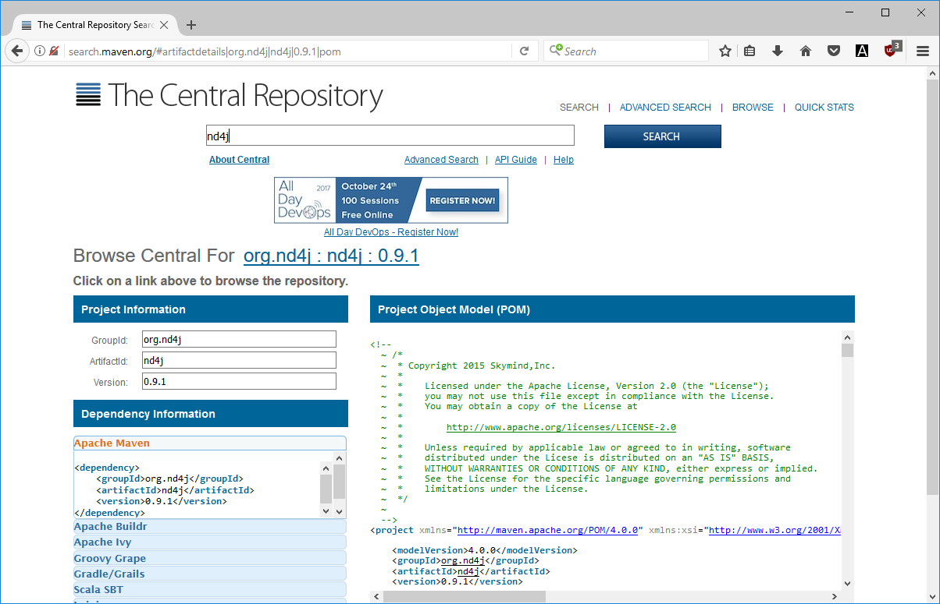
Exploring Libraries
JVM libraries can be searched and downloaded on https://search.maven.org
GitHub is an effective hub for exploring documentation and resources for libraries: https://github.com/

Slide 9
Resources
Kotlin Official site (http://kotlinlang.org/)
Kotlin Reference (http://kotlinlang.org/docs/reference/)
Kotlin Slack Community (http://slack.kotlinlang.org/)
O’Reilly Introduction to Kotlin Programming (https://goo.gl/zaxztZ)
O’Reilly Advanced Kotlin (https://goo.gl/azU9Fp)
Manning Kotlin in Action (https://goo.gl/1LQHos)

